Slide 1
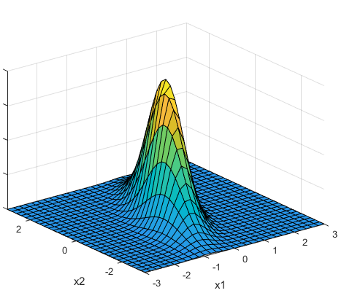
A primer on Bayesian statistics for introductory statistical machine learning Christopher A. Penfold Gurdon Lab Wellcome/CRUK Gurdon Institute

Slide 2
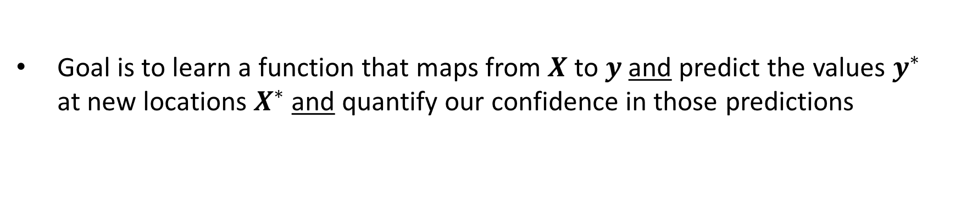
Supervised learning
Goal is to learn a function that maps from $X$ to $y$ and predict the values $y^{∗}$ at new locations $X^{∗}$ and quantify our confidence in those predictions

Slide 3
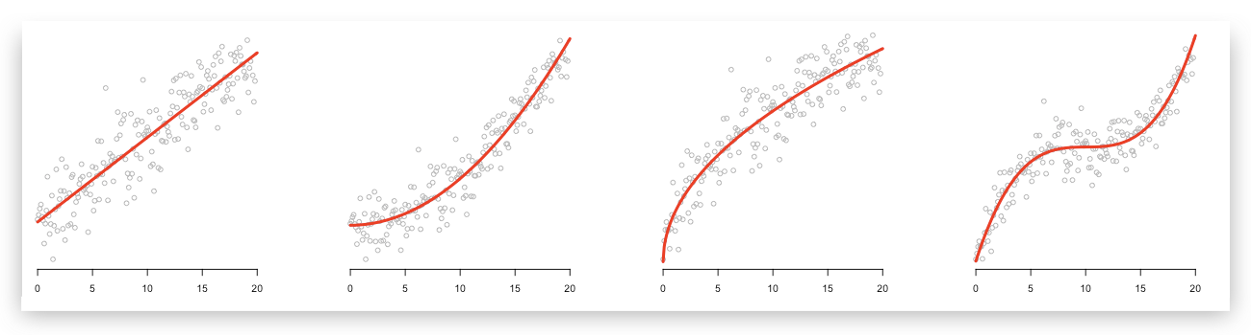
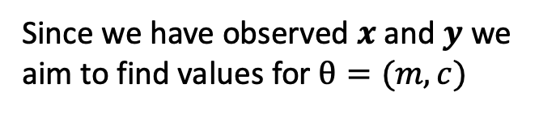
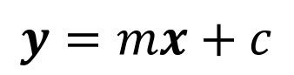
Linear regression
$$y=mx+c$$
Since we have observed $x$ and $y$ we aim to find values for $θ=(m,c)$

Slide 4
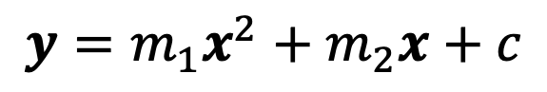
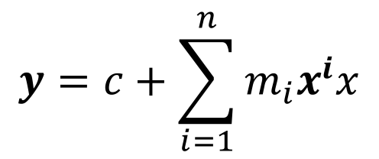
Polynomial regression
$$y=m_{1}x^{2}+m_{2}x+c$$
$$θ=(m_{1},…,m_{n},c)$$
$$y=c+\sum_{i=1}^{n}{m_{i}x^{i}x}$$

Slide 5
Polynomial regression
Set of (noisy) data

Slide 6
Polynomial regression
Set of (noisy) data
Can fit a polynomial

Slide 7
Polynomial regression
Set of (noisy) data
Can fit a polynomial
What about this polynomial?

Slide 8
Polynomial regression
Set of (noisy) data
Can fit a polynomial
What about this polynomial?
Higher order polynomial would pass closer to more data points

Slide 9
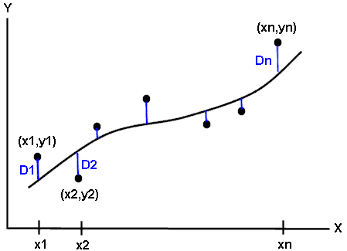

Polynomial regression
Split the data: training and test set
Want an objective way to measure if a model is truly learning about the system or simply interpolating through the data (noise)
Too simple a model won’t have the descriptive power to explain the observations (underfitting)
Too complex a model will be able to describe the training data very well, but won’t generalise to the test data (overfitting)

Slide 10
Polynomial regression
Are there other ways that don’t require us to split data?
Use the language of probability to quantify uncertainty

Slide 11
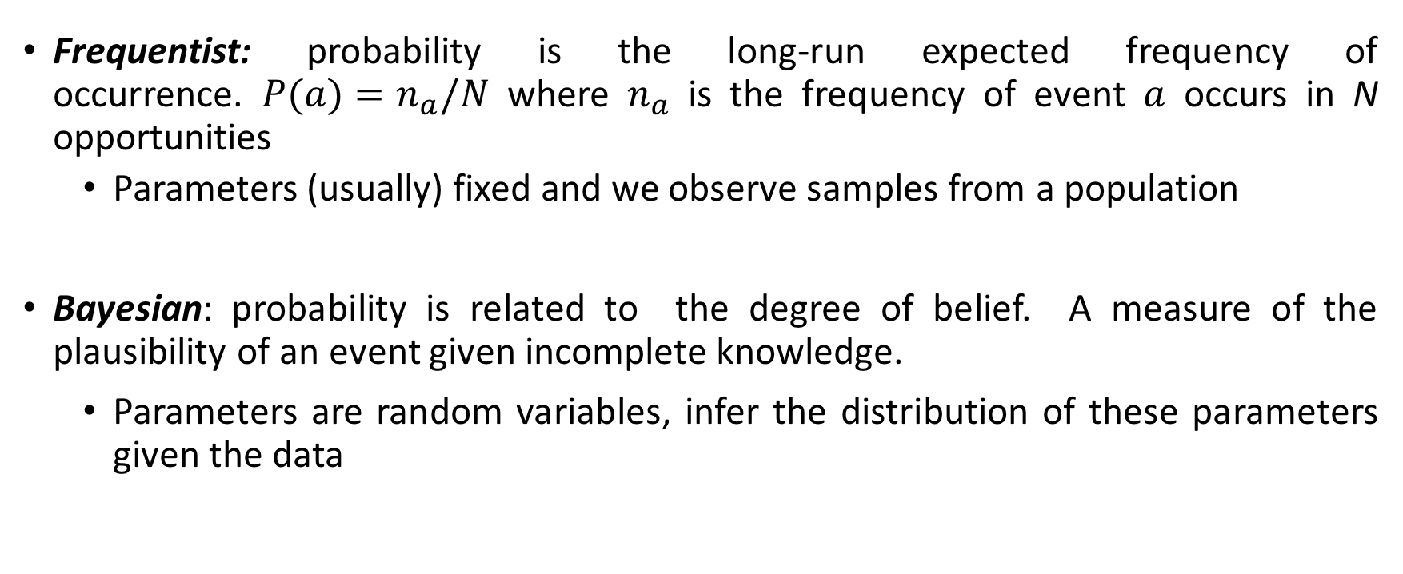
A primer on statistics
Frequentist: probability is the long-run expected frequency of occurrence. $P(a)=n_{a}/N$where $n_{a}$ is the frequency of event $a$ occurs in N opportunities
Parameters (usually) fixed and we observe samples from a population
Bayesian: probability is related to the degree of belief. A measure of the plausibility of an event given incomplete knowledge.
Parameters are random variables, infer the distribution of these parameters given the data

Slide 12
A primer on statistics
Let’s start by flipping a coin
What is the probability of seeing a head? p_{H}

Slide 13
A primer on statistics
Let’s start by flipping a coin
What is the probability of seeing a head? p_{H}
We know this will have a value somewhere between 0 and 1
If the coin is unbiased we have p = 0.5

Slide 14
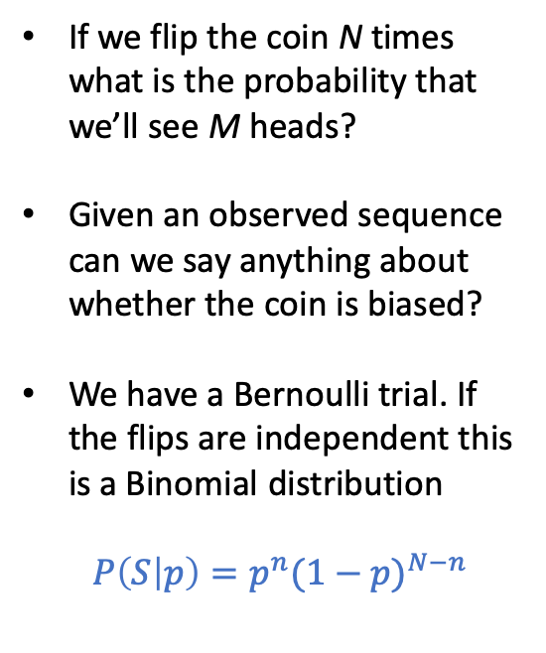
A primer on statistics
If we flip the coin N times what is the probability that we’ll see M heads?
Given an observed sequence can we say anything about whether the coin is biased?
We have a Bernoulli trial. If the flips are independent this is a Binomial distribution
$P\left(S | p\right)=p^{n}{(1−p)}^{N−n}$
TT
HT
TH
HH

Slide 15
A primer on statistics
…
TTT
HTT
THT
TTH
HHT
HTH
THH
HHH

Slide 16
A primer on statistics
…

Slide 17
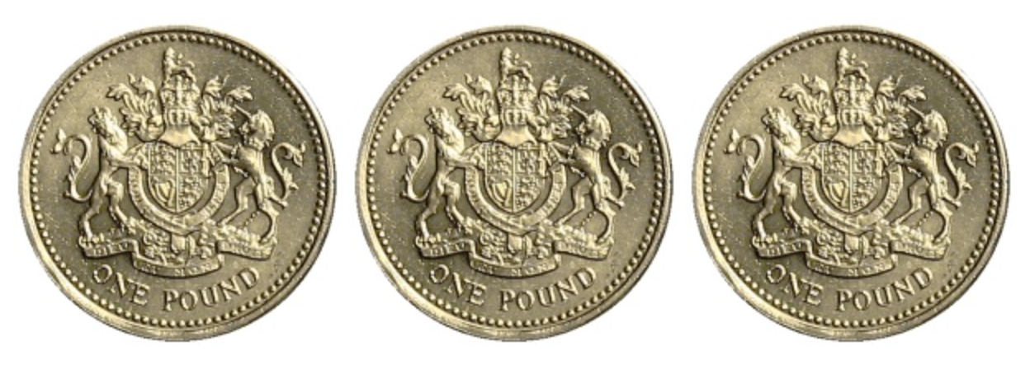
Null hypothesis: our coin is unbiased
Given that the null hypothesis is true what is the probability that the statistic summary you observe is greater than or equal to the value you observed?
We flip a coin N times and get M tails. What is the probability that we would observed >= M tails
Virtual coin flip: www.random.org/coins

Slide 18
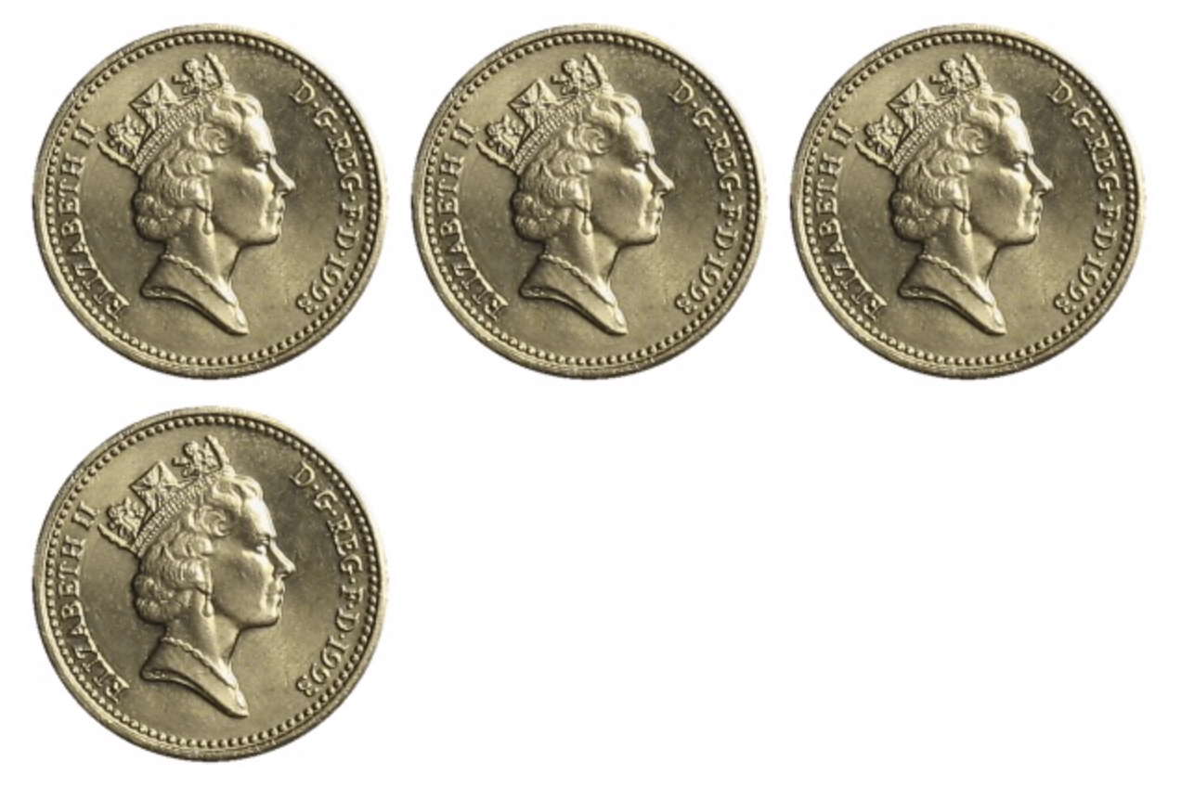
Virtual coin flip: www.random.org/coins

Slide 19
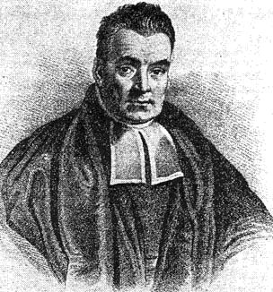
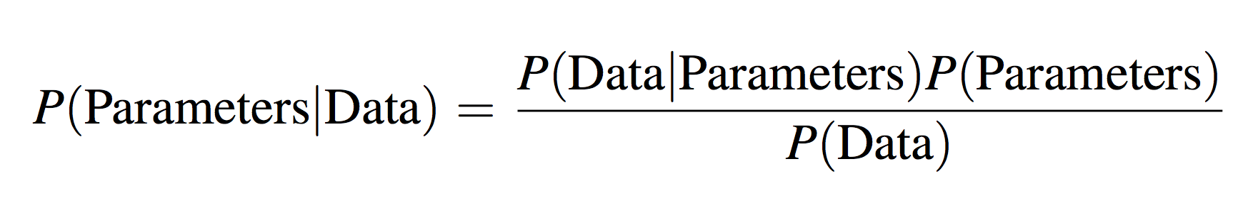
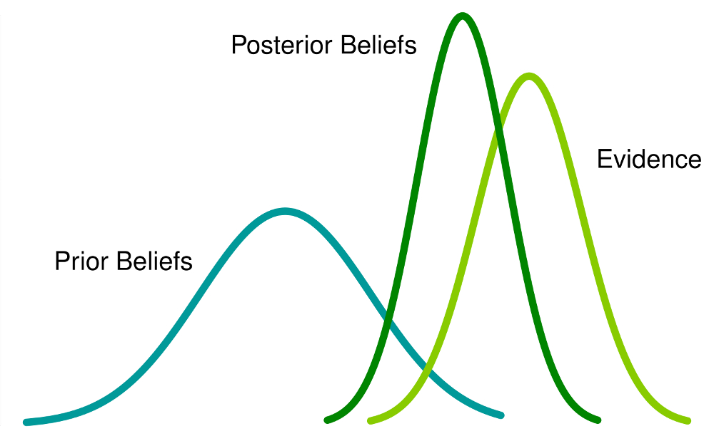
A primer on Bayesian inference
Notes:
Kristian Lum

Slide 20

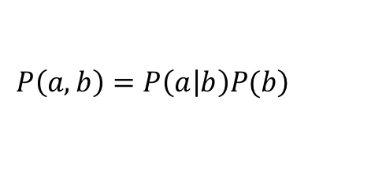
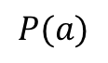

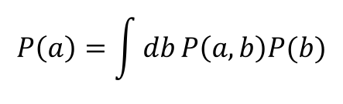
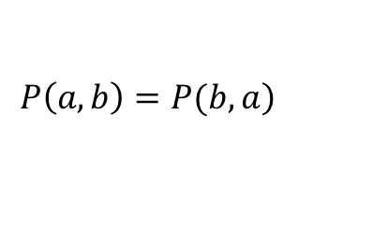
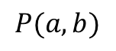
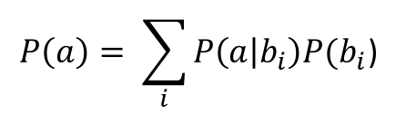
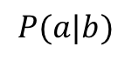

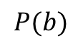
A primer on Bayesian inference
A few definitions:
$$P(a)$$
The probability that $a$ happens
$$P(b)$$
The probability that $b$ happens
Joint probability:
$$P(a,b)$$
The probability that $a$ and $b$ happens
Conditional probability:
$$P(a|b)$$
The probability that $a$ happens given an observed value for $b$
$$\left.P\left(a,b\right)=P\left(a | b\right)P(b\right)$$
Decompose joint distribution into condition
$$P\left(a\right)= \sum_{i}{P\left(a | b_{i}\right)P(b_{i}\text{)}}$$
$$P\left(a\right)=\int{db}P\left(a,b\right)P(b)$$
Marginalise:
$$\left.P\left(a,b\right)=P(b,a\right)$$

Slide 21
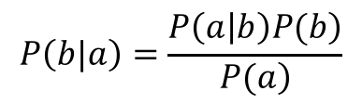
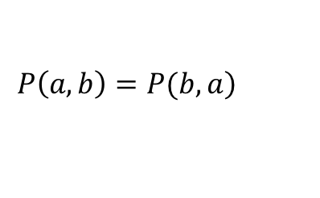
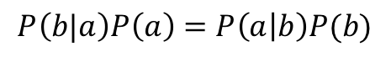
A primer on Bayesian inference
Probabilities are commutative:
$$\left.P\left(a,b\right)=P(b,a\right)$$
Putting them together for Bayes rule:
$$P\left(b|a\right)P\left(a\right)=P\left(a | b\right)P(b)$$
$$P\left(b|a\right)=\frac{\left.P\left(a | b\right)P(b\right)}{\left.P(a\right)}$$

Slide 22
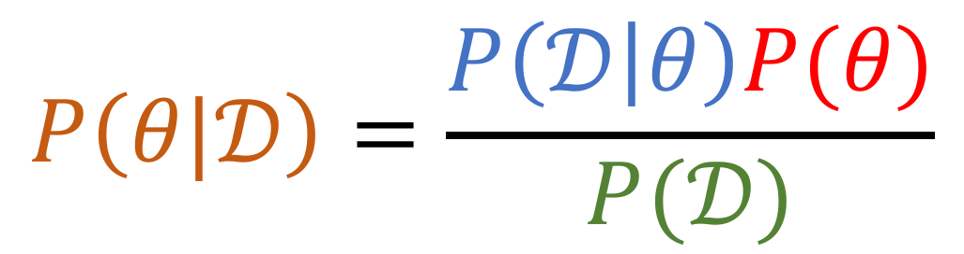
A primer on Bayesian inference
Posterior distribution
Likelihood
Prior distribution
$$P\left(θ|𝒟\right)=\frac{P\left(𝒟 | θ\right)P(θ)}{P(𝒟)}$$
Marginal likelihood or “evidence”
Or … if to make an observation that diverges largely from all current knowledge you need a lot of evidence

Slide 23
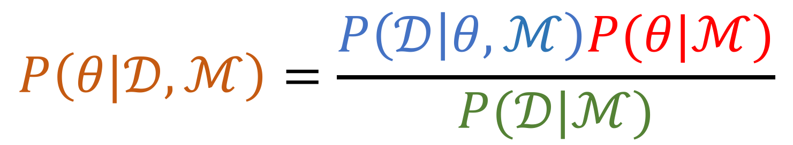
A primer on Bayesian inference
Posterior distribution
Likelihood
Prior distribution
$$P\left(θ|𝒟,ℳ\right)=\frac{P\left(𝒟 | θ,ℳ\right)P(θ|ℳ)}{P(𝒟|ℳ)}$$
Marginal likelihood or “evidence”
Or … if to make an observation that diverges largely from all current knowledge you need a lot of evidence

Slide 24
A primer on Bayesian inference
What you now believe about the system
What your data is saying
What’s already known about the system
Posterior distribution
Likelihood
Prior distribution
$$P\left(θ|𝒟,ℳ\right)=\frac{P\left(𝒟 | θ,ℳ\right)P(θ|ℳ)}{P(𝒟|ℳ)}$$
Marginal likelihood or “evidence”
Given your model how likely were you to have generated the observations you did
Or … if to make an observation that diverges largely from all current knowledge you need a lot of evidence

Slide 25
Doing Bayesian inference
Virtual coin flip: www.random.org/coins

Slide 26
Doing Bayesian inference
What is the likelihood of observing this sequence of events?
Are the flips independent? Binomial distribution.
Is the coin biased? Can we say anything about the probability, p, of seeing a head next time?
What is the uncertainty in p?

Slide 27

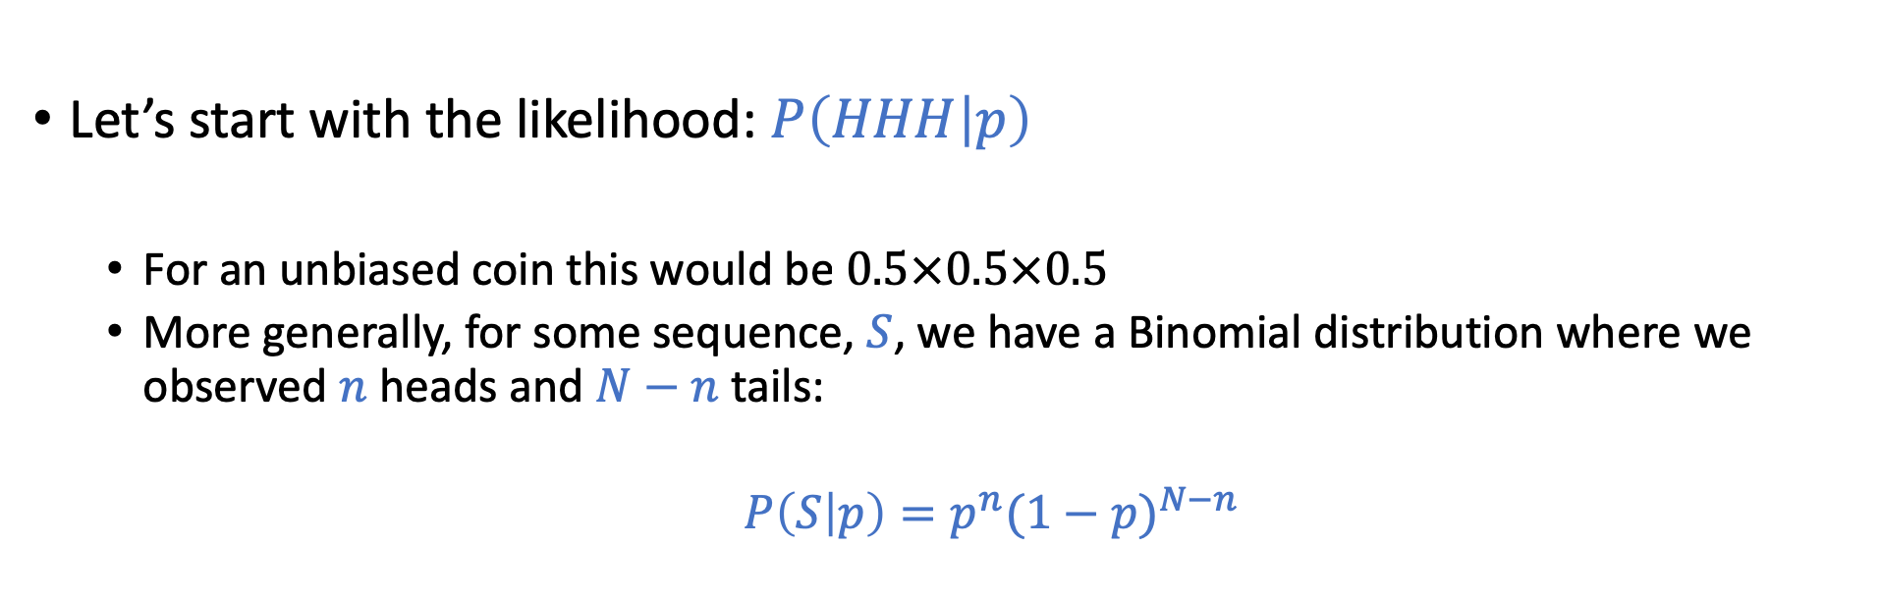
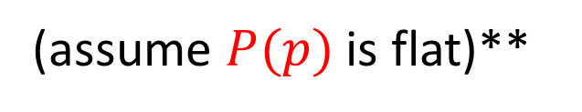
Doing Bayesian inference
$$P\left(p|HHH\right)=\frac{P\left(HHH | p\right)P(p)}{P(𝒟)}$$
Apply Bayes’ rule:
Let’s start with the likelihood: $P\left(HHH | p\right)$
For an unbiased coin this would be $0.5×0.5×0.5$
More generally, for some sequence, $S$, we have a Binomial distribution where we observed $n$ heads and $N−n$ tails:
$P\left(S | p\right)=p^{n}{(1−p)}^{N−n}$
(assume $P(p)$ is flat)**

Slide 28
Doing Bayesian inference
Apply Bayes’ rule:
$$P\left(p|HHH\right)∝P\left(HHH | p\right)P(p)$$
Let’s start with the likelihood: $P\left(HHH | p\right)$
For an unbiased coin this would be $0.5×0.5×0.5$
More generally, for some sequence, $S$, we have a Binomial distribution where we observed $n$ heads and $N−n$ tails:
$P\left(S | p\right)=p^{n}{(1−p)}^{N−n}$
(assume $P(p)$ is flat)**

Slide 29
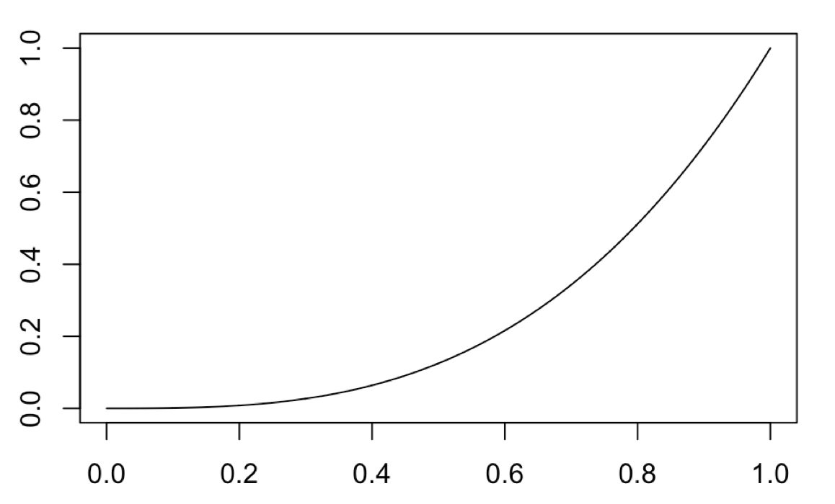

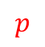
Doing Bayesian inference
coinflip <- function(p, N, n){
P <- p^n * (1-p)^(N-n) * 1
return(P)
}
L=lapply(seq(0,1,0.001),coinflip, 3, 3)
plot(seq(0,1,0.001),unlist(L),type="l")
$$P(p)$$
$$p$$

Slide 30
Doing Bayesian inference
coinflip <- function(p, N, n){
P <- p^n * (1-p)^(N-n) * 1
return(P)
}
L=lapply(seq(0,1,0.001),coinflip, 3, 3)
plot(seq(0,1,0.001),unlist(L),type="l")
$$P(p)$$
$$p$$
Most likely parameter value: Maximum likelihood or maximum a posteriori (MAP)

Slide 31
Doing Bayesian inference
coinflip <- function(p, N, n){
P <- p^n * (1-p)^(N-n) * 1
return(P)
}
L=lapply(seq(0,1,0.001),coinflip, 3, 3)
plot(seq(0,1,0.001),unlist(L),type="l")
$$P(p)$$
$$p$$
But we have a distribution: what are the 95% confidence intervals

Slide 32

Doing Bayesian inference
Okay we’ve been a little bit naughty with our prior distribution
Bayes’ rule:
$$P\left(p|HHH\right)∝P\left(HHH | p\right)P(p)$$
Okay, now let’s try setting doing something sensible with $P(p)$

Slide 33
Doing Bayesian inference
Need to think of how we set our prior belief.

Slide 34
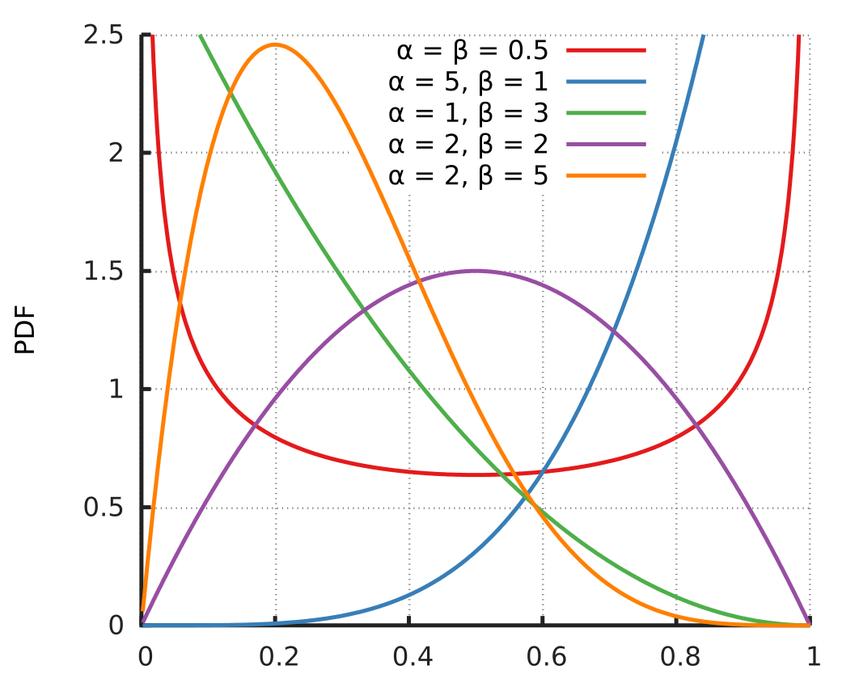
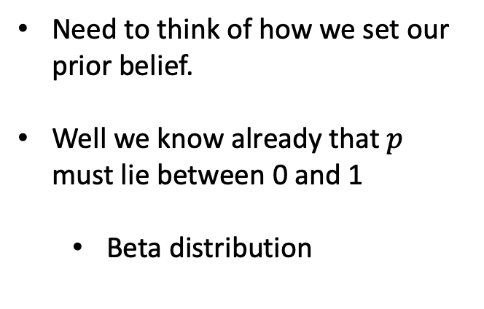
Doing Bayesian inference
Need to think of how we set our prior belief.
Well we know already that $p$ must lie between 0 and 1
Beta distribution

Slide 35
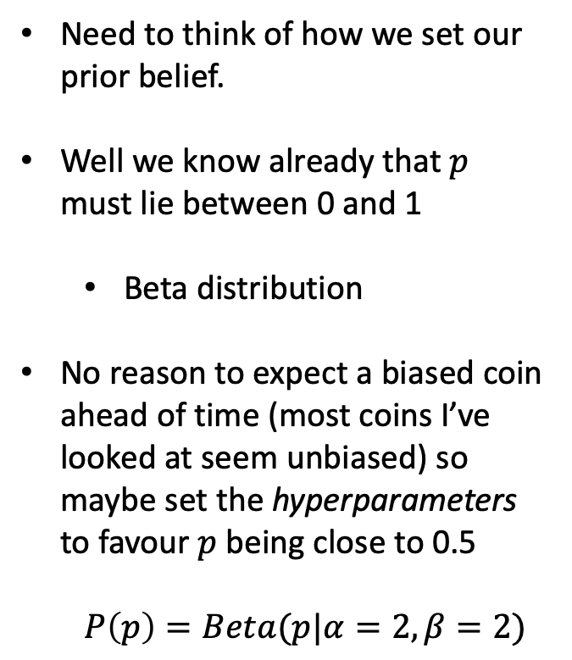
Doing Bayesian inference
Need to think of how we set our prior belief.
Well we know already that $p$ must lie between 0 and 1
Beta distribution
No reason to expect a biased coin ahead of time (most coins I’ve looked at seem unbiased) so maybe set the hyperparameters to favour $p$ being close to 0.5
$$P\left(p\right)=Beta(p|α=2,β=2)$$

Slide 36
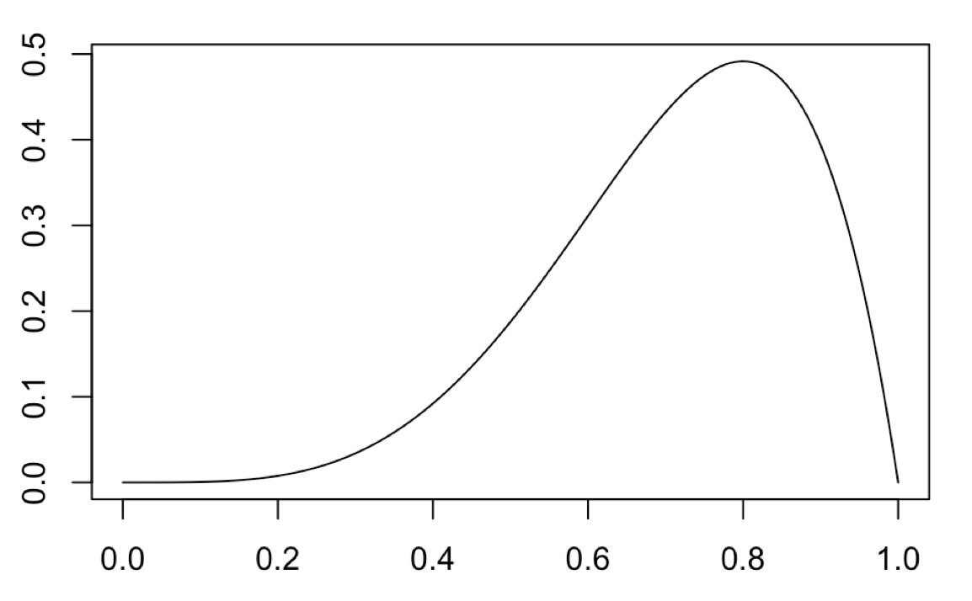
Doing Bayesian inference
coinflip <- function(p, N, n){
P <- p^n * (1-p)^(N-n) *
dbeta(p, 2, 2, ncp = 0, log = FALSE)
return(P)
}
L=lapply(seq(0,1,0.001),coinflip, 3, 3)
plot(seq(0,1,0.001),unlist(L),type="l")

Slide 37
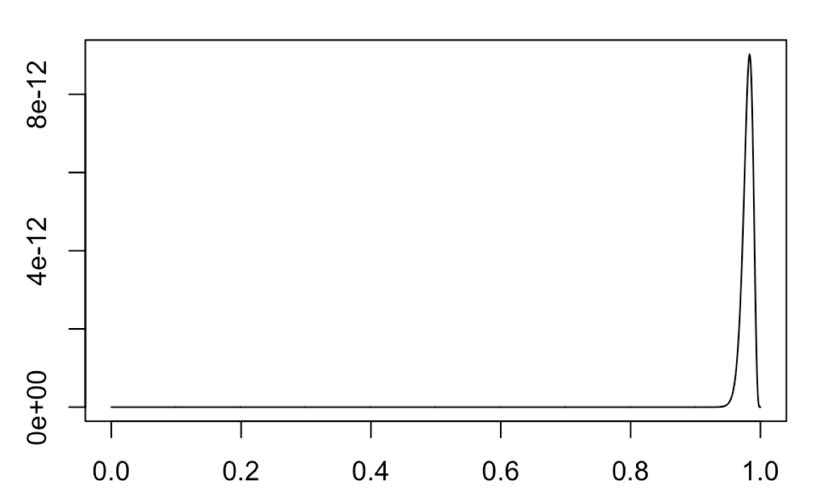
Doing Bayesian inference
Seems a little like we’re telling it the answer before hand!
What happens when we have many observations from a biased coin?
295 heads from 300 observations
Keep the same prior (no bias)
If you make exceptional claims you should have exceptional evidence

Slide 38
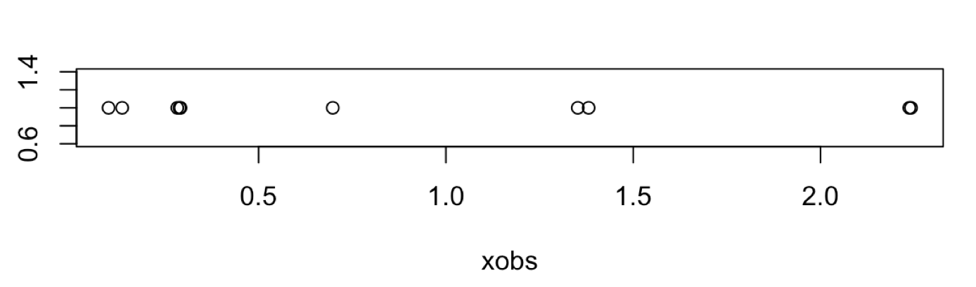
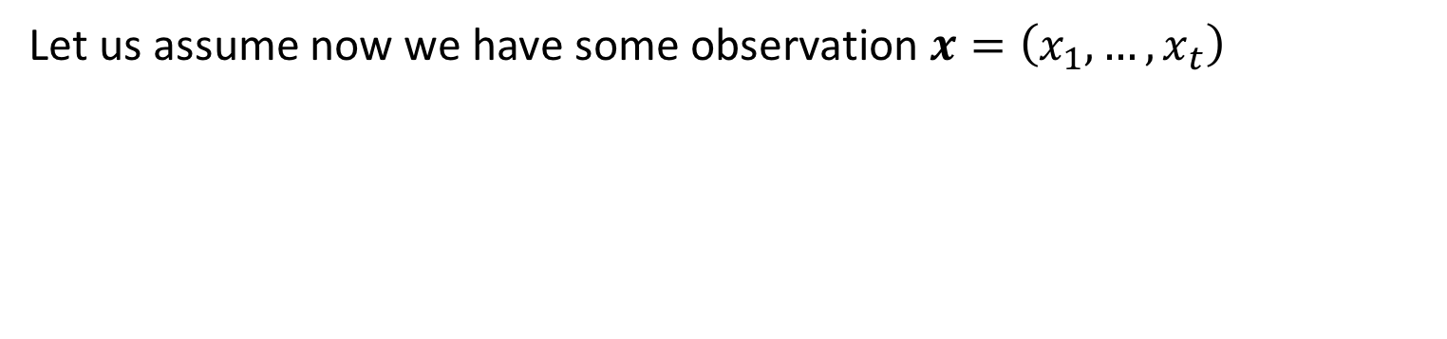
Doing Bayesian inference
Let us assume now we have some observation $x=\left(x_{1},…,x_{t}\right)$
How do we model this?
.

Slide 39
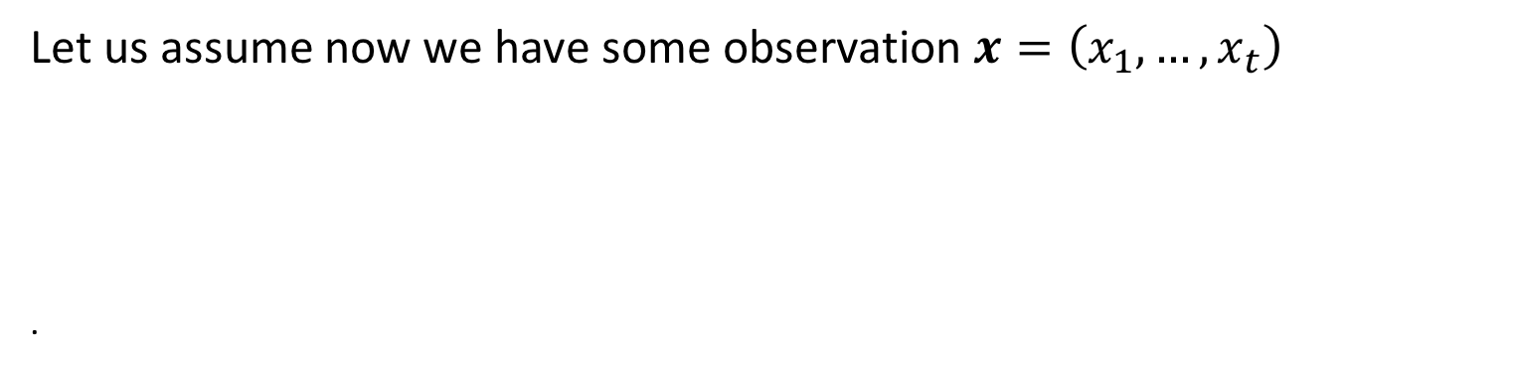
Doing Bayesian inference
Let us assume now we have some observation $x=\left(x_{1},…,x_{t}\right)$
.
How do we model this? Looks continuous …
.

Slide 40
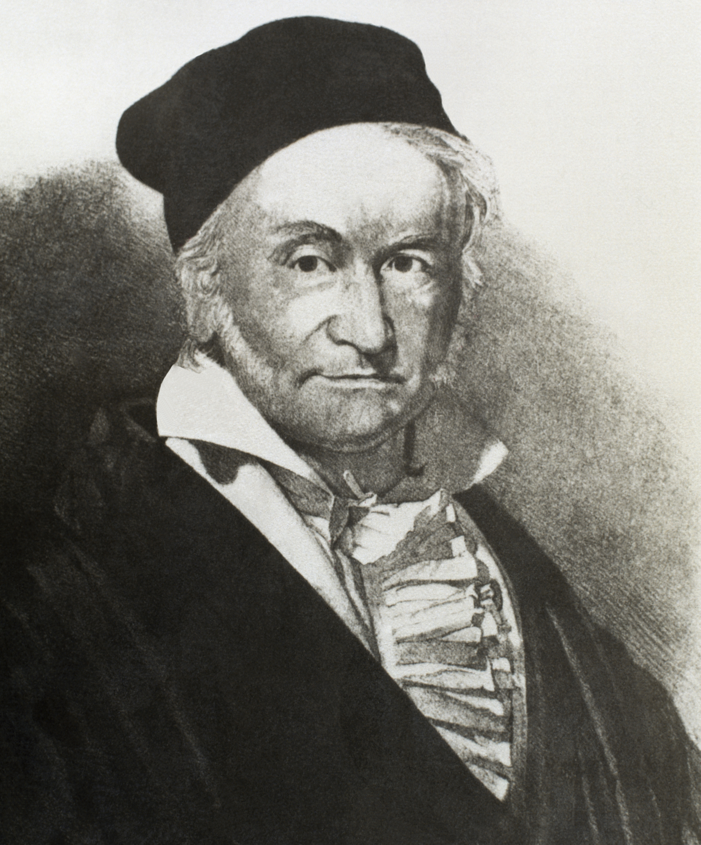
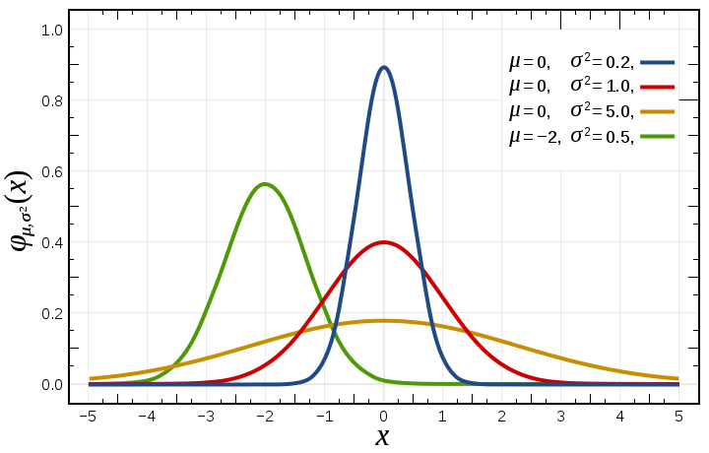
Doing Bayesian inference

Slide 41
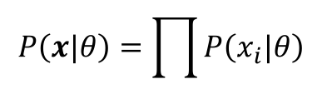
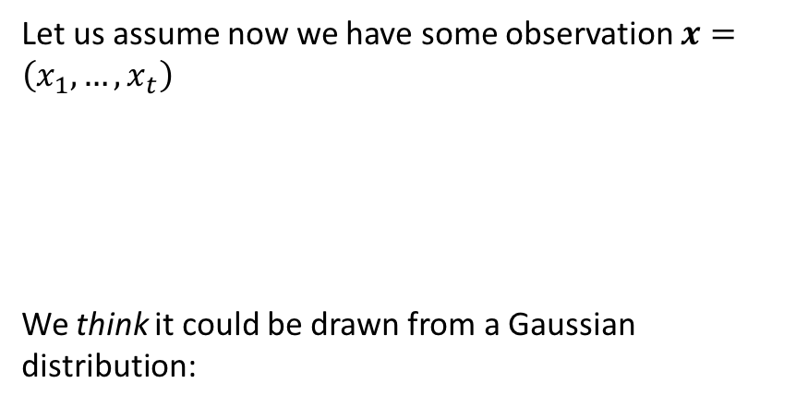
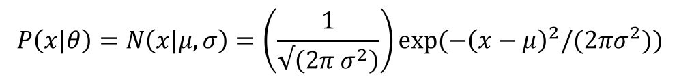
Doing Bayesian inference
Let us assume now we have some observation $x=\left(x_{1},…,x_{t}\right)$
We think it could be drawn from a Gaussian distribution:
$$P\left(x|θ\right)=N\left(x|μ,σ\right)=\left(\frac{1}{√\left(2π σ^{2}\right)}\right)exp⁡({−\left(x−μ\right)}^{2}/(2πσ^{2}))$$
Likelihood:
$$P\left(x|θ\right)=\prod{P\left(x_{i}|θ\right)}$$

Slide 42
Doing Bayesian inference
Let us assume now we have some observation $x=\left(x_{1},…,x_{t}\right)$
We think it could be drawn from a Gaussian distribution:
gaussiandist <- function(x, mu, sigma){
L <- prod((1/(sqrt(2*pi*sigma^2))) * exp(-(x-mu)^2 / (2*sigma^2)))
return(L)
}
mu = seq(-5,5,0.001)
sigma = seq(0.001,1.5,0.001)
L<-matrix(0,length(mu),length(sigma))
for (i in 1:length(mu)) {
for (j in 1:length(sigma)) {
L[i,j]<-gaussiandist(xobs,mu[i],sigma[j]) }
}
$$P\left(x|θ\right)=N\left(x|μ,σ\right)=\left(\frac{1}{√\left(2π σ^{2}\right)}\right)exp⁡({−\left(x−μ\right)}^{2}/(2πσ^{2}))$$
Likelihood:
$$P\left(x|θ\right)=\prod{P\left(x_{i}|θ\right)}$$

Slide 43
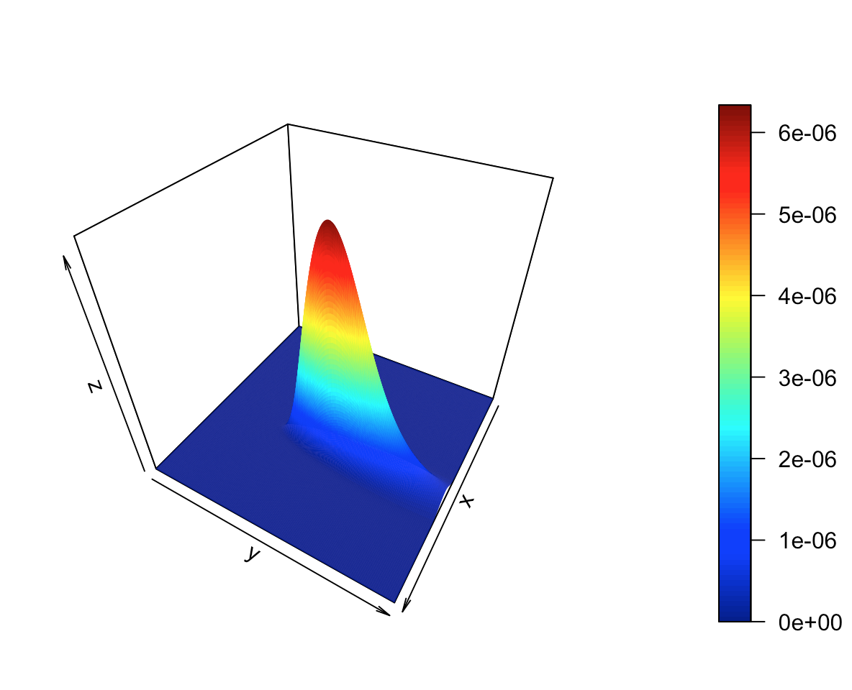
Doing Bayesian inference
gaussiandist <- function(x, mu, sigma){
L <- prod((1/(sqrt(2*pi*sigma^2))) * exp(-(x-mu)^2 / (2*sigma^2)))
return(L)
}
mu = seq(-5,5,0.001)
sigma = seq(0.001,1.5,0.001)
L<-matrix(0,length(mu),length(sigma))
for (i in 1:length(mu)) {
for (j in 1:length(sigma)) {
L[i,j]<-gaussiandist(xobs,mu[i],sigma[j]) }
}

Slide 44
Doing Bayesian inference
Actually … a friend of mine just took a look at the data and said whoever told me it was Gaussian is talking rubbish.

Slide 45
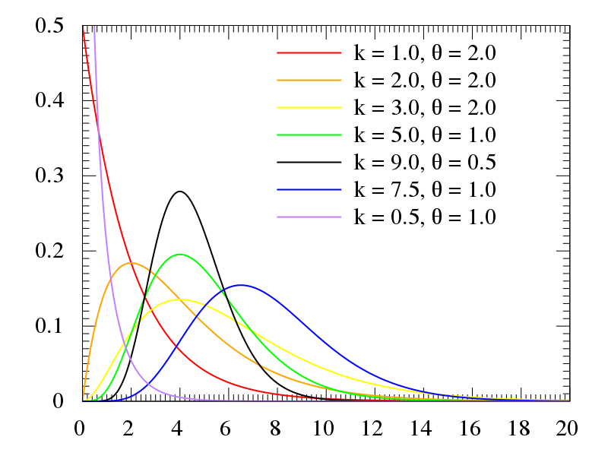
Doing Bayesian inference

Slide 46
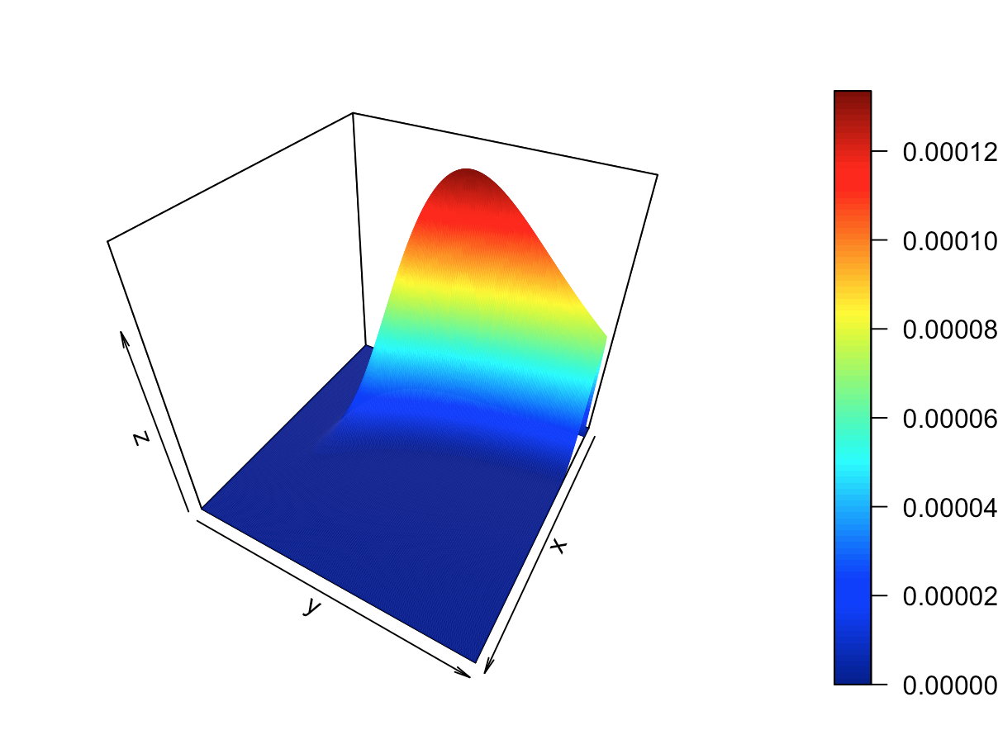
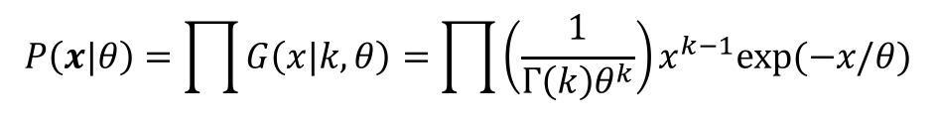
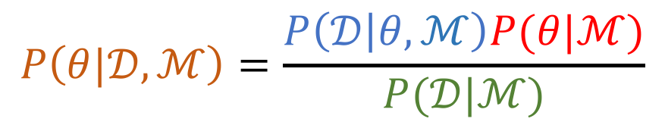
$$P\left(θ|𝒟,ℳ\right)=\frac{P\left(𝒟 | θ,ℳ\right)P(θ|ℳ)}{P(𝒟|ℳ)}$$
Doing Bayesian inference
Okay, let’s try a different model. Let us assume a gamma distribution:
$$P\left(x|θ\right)=\prod{G\left(x|k,θ\right)}=\prod{\left(\frac{1}{Γ\left(k\right)θ^{k}}\right)x^{k−1}exp⁡(−x/θ)}$$
gammadist <- function(x, k, theta){
L <- prod((1/(gamma(k)*theta^k))x^(k-1)*exp(-x/theta))
return(L)
}

Slide 47


Doing Bayesian inference
$$P\left(θ|𝒟,ℳ\right)=\frac{P\left(𝒟 | θ,ℳ\right)P(θ|ℳ)}{P(𝒟|ℳ)}$$
$$P\left(𝒟 | ℳ\right)=\int{dθ}P\left(𝒟 | θ,ℳ\right)P(θ|ℳ)$$

Slide 48





Doing Bayesian inference
$$P(𝒟|ℳ_{1})$$
$$P(𝒟|ℳ_{2})$$
$$\int{dθ}P\left(𝒟 | θ,ℳ\right)P(θ|ℳ)$$
I1<-matrix(0,length(mu),1
for (i in 1:length(mu)) {
I1[i,1]<-trapz(sigma,L1[i,])
}
intGauss<-trapz(mu,I1)
I2<-matrix(0,length(k),1)
for (i in 1:length(k)) {
I2[i,1]<-trapz(theta,L[i,])
}
intGamma<-trapz(k,I2)
$$\int{dθ}P\left(𝒟 | θ,ℳ_{1}\right)P\left(θ | ℳ_{1}\right)=\text{2.166697}\text{e}\text{−06}$$
$$\int{dθ}P\left(𝒟 | θ,ℳ_{2}\right)P\left(θ | ℳ_{2}\right)=\text{7.583745}\text{e}\text{−05}$$
Notes:
xobs <- rgamma(10, shape=1, rate = 1)

Slide 49
Doing Bayesian inference
$$P(𝒟|ℳ_{1})$$
$$P(𝒟|ℳ_{2})$$
$$\int{dθ}P\left(𝒟 | θ,ℳ\right)P(θ|ℳ)$$
I1<-matrix(0,length(mu),1
for (i in 1:length(mu)) {
I1[i,1]<-trapz(sigma,L1[i,])
}
intGauss<-trapz(mu,I1)
I2<-matrix(0,length(k),1)
for (i in 1:length(k)) {
I2[i,1]<-trapz(theta,L[i,])
}
intGamma<-trapz(k,I2)
$$\int{dθ}P\left(𝒟 | θ,ℳ_{1}\right)P\left(θ | ℳ_{1}\right)=\text{2.166697}\text{e}\text{−06}$$
$$\int{dθ}P\left(𝒟 | θ,ℳ_{2}\right)P\left(θ | ℳ_{2}\right)=\text{7.583745}\text{e}\text{−05}$$
xobs <- rgamma(10, shape=1, rate = 1)
Notes:
xobs <- rgamma(10, shape=1, rate = 1)

Slide 50


So what?
Can we do regression in a probabilistic (Bayesian) way?
Place prior distributions over the parameters e.g., m, c
$$y=mx+c$$
$$y=m_{1}x^{2}+m_{2}x+c$$

Slide 51

(Bayesian) polynomial regression

Slide 52

Gaussian process regression
How about we place a prior distribution directly over the function itself
$$y=f(x)+noise$$
$$P\left(f|y\right)∝P\left(y | f\right)P\left(f\right)$$

Slide 53


Slide 54
I like these.
Any way to put them together?

Slide 55
I like these.
Any way to put them together?
Gaussian process regression

Slide 56

Tasks
Use linear and nonlinear regression to analyse Arabidopsis thaliana gene expression time series data following inoculation with the necrotrophic fungus Botrytis cinereal
(optional) Use marginal likelihood to distinguish different models

Slide 57
Hyperparameters
Use marginal likelihood to select optimal hyperparameters:
Grid search
Gradient optimisation

Slide 58
Classification

Slide 59
Classification
Supervised learning
Usually a tuple of observations (X,y)
Output y is a discrete (categorical) output e.g., binary y_{i} ∈ [0,1]
Some algorithms require us to represent y in one-hot encoding
y = (1,1,3,0,2,1)ᵀ
[0,1,0,0;
0,1,0,0;
0,0,0,1;
1,0,0,0;
0,0,1,0;
0,1,0,0]
one-hot
?
Goal is to identify function (mapping) from X to y
Identify a decision boundary

Slide 60

Classification
As before split the data into a training set and validation set
Class imbalance in classification

Slide 61

Evaluating performance: Receiver operating characteristics
Confusion matrix:
True positive: Predict y = 1, observation y = 1.
True negative: Predict y = 0, obs. y = 0.
False positive: Predict y = 1, obs. y = 0.
False negative: Predict y = 0, obs. y = 1.
Plot false positive rate (FPR) versus true positive rate (TPR):
TPR = TP/(TP+FN)
FPR = FP/(FP+TN)
Area under the curve (AUC)

Slide 62

Evaluating performance: Precision recall curve
Confusion matrix:
True positive: Predict y = 1, observation y = 1.
True negative: Predict y = 0, obs. y = 0.
False positive: Predict y = 1, obs. y = 0.
False negative: Predict y = 0, obs. y = 1.
Plot precision recall curves:
precision = TP/(TP+FP)
recall = TP/(TP+FN)
Area under the precision-recall curve (PR)

Slide 63

Logistic regression
Binary valued outputs, y, so linear regression is no good!

Slide 64




Logistic regression
Model probability of success
Solve for x
R PSEUDOCODE
lrfit <- train(y ~ ., data, method="glm", family="binomial")
Likelihood

Slide 65

GP classification
R PSEUDOCODE
gpcfit <- train(y~., data, method="gaussprPoly")

Slide 66
Classification
Logistic regression
Gaussian process classification
Support Vector Machine (SVM)
Random forests
Neural networks
Ensemble approaches
CODE
mod <- train(y ~ ., method = "glm", family = "Binomial")
mod <- train(y ~ ., method = ”gaussprPoly")
mod <- train(y ~ ., method = "svmRadial")
mod <- train(y ~ ., method = "mxnet")

Slide 67


Slide 68


X
https://www.r-bloggers.com/whats-the-difference-between-machine-learning-statistics-and-data-mining/
Statistics and machine learning are fundamentally different. Statistics aims to provide a human with the tools to analyze data. Machine learning wants to replace the human in the processing of data.
Neil Lawrence (http://inverseprobability.com)

Slide 69
Tasks
Use logistic regression and GP classification to look for marker genes that are indicative of infection status

Slide 70

$$y=f(x)+noise$$

